Slide 1



CAR RENTAL APPLICATION
Group No: 09

Slide 2








Meet our Team Members
M. Sushma
Kukati Suma
2587751
2587073
Marthula Vikitha
Divya Botre
2586840
2587484
Jaya Veeresh N
Harshavardhan Katukojwala
2587052
2587314
Kondakamarla Shabeer
Moulish R
2586907
2587407
2

Slide 3
Agenda
Introduction
Abstract
Advantages
Technologies Used
Environment
Screenshots
Data Flow
J-Unit Testing
Conclusion

Slide 4

Introduction
Your Car Rental is a car rental service for everyone.
It is user- friendly, thus helping in better utilization of the resources. This project offers the best of services-both in terms of man and machine.
It offers the online car rental service for travel agencies.
It offers the best of rates and include the different categories of cars from luxury to budget.
Our Car Rental service will also provide Accumulate loyalty points for Regular Customers.
4

Slide 5


The Car Rental System is being developed for customers so that they can book their vehicles from any part of the world. This application takes information from the customers through filling their details. A customer being registered in the website has the facility to book a vehicle which he requires. Car rental management system is a project which aims in developing a computerized system to maintain all the daily work of Car Rental . It also has a facility of admin login through which the admin can monitor the whole system . It also has facility of an online notice board where Admin can put up information about the cars available in the exhibition and their prices and updating all data that go through the rental process. It has also a facility where user after logging in their accounts can see list of cars and its price and Availability of the car. Overall, this project of ours is designed to help anyone make it easier during the process of renting a car in the best possible way, as well as reducing human efforts and obtaining the best.
ABSTRACT

Slide 6
Technology Used
Junit
MySQL
Post-man
MySQL database has been used as database for the project.
Postman is an API platform for building and using APIs
JUnit is a unit testing open-source framework for the Java programming language
Angular CLI
Command-line interface tool that we use to initialize.
Hibernate
Spring-boot
Used for object table mapping.
Server side setup.
6

Slide 7






ENVIRONMENT
Node Version 10
Eclipse IDE
Spring Tool Suite
Angular Version 16.2.4
Visual Studio Code
Database – MySQL

Slide 8
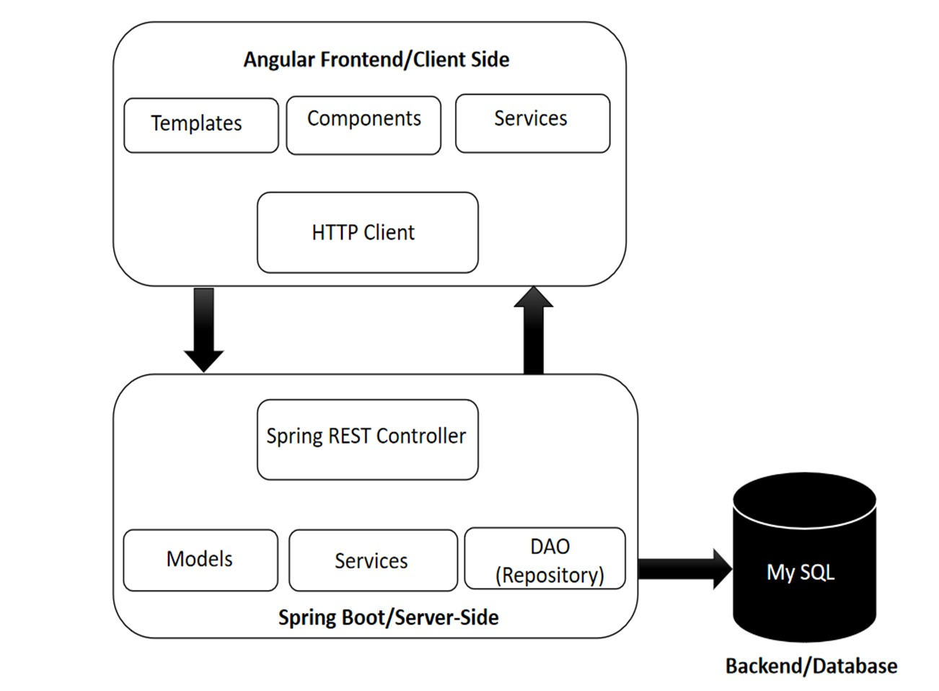
DATA FLOW
8

Slide 9
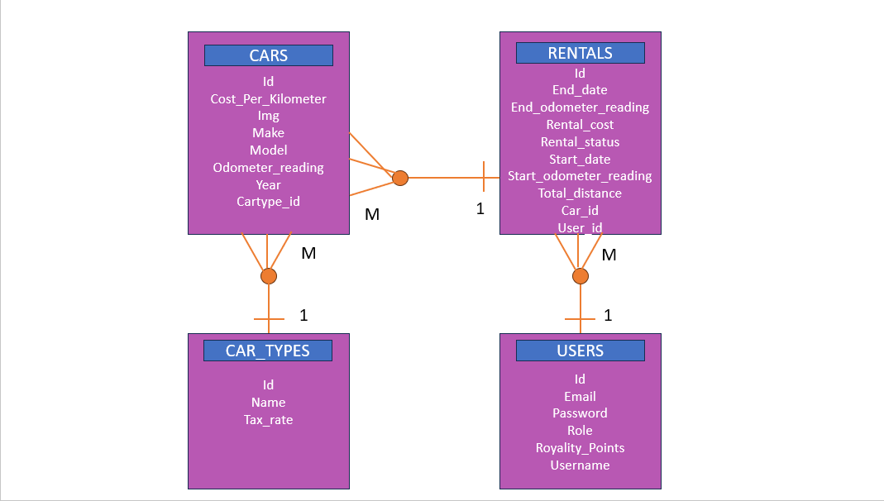
ER Diagram
9

Slide 10
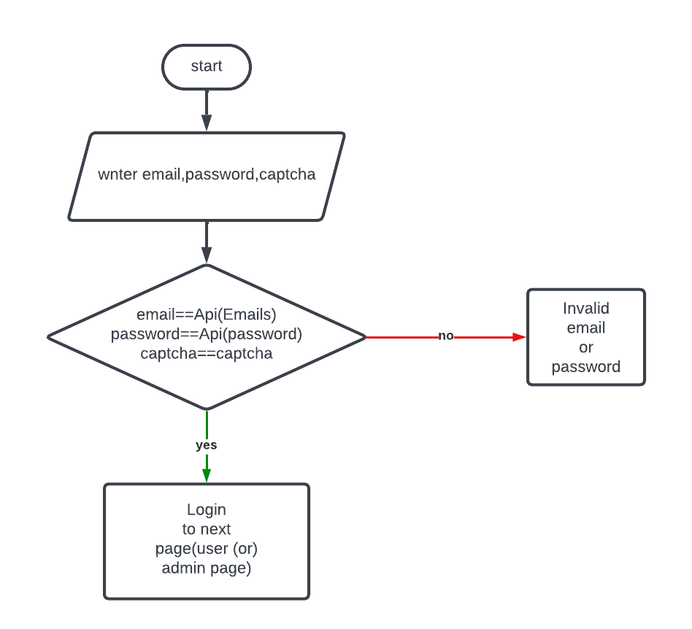
Flowchart for Login
10

Slide 11
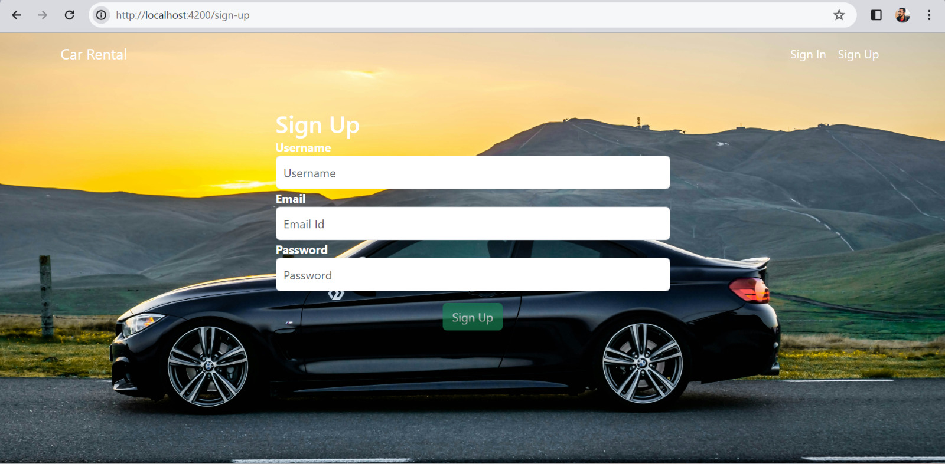
SIGN UP PAGE [USER]
11

Slide 12
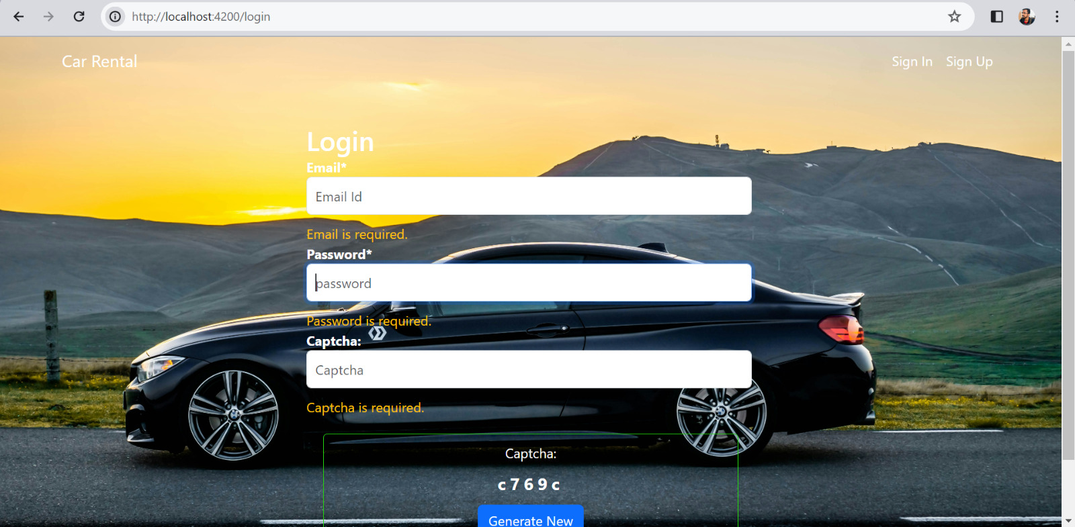
LOGIN PAGE [ADMIN & USER]
12

Slide 13
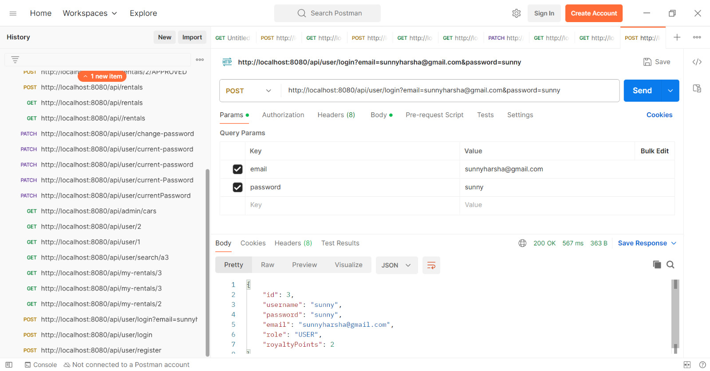
LOGIN PAGE [TESTING]
13

Slide 14
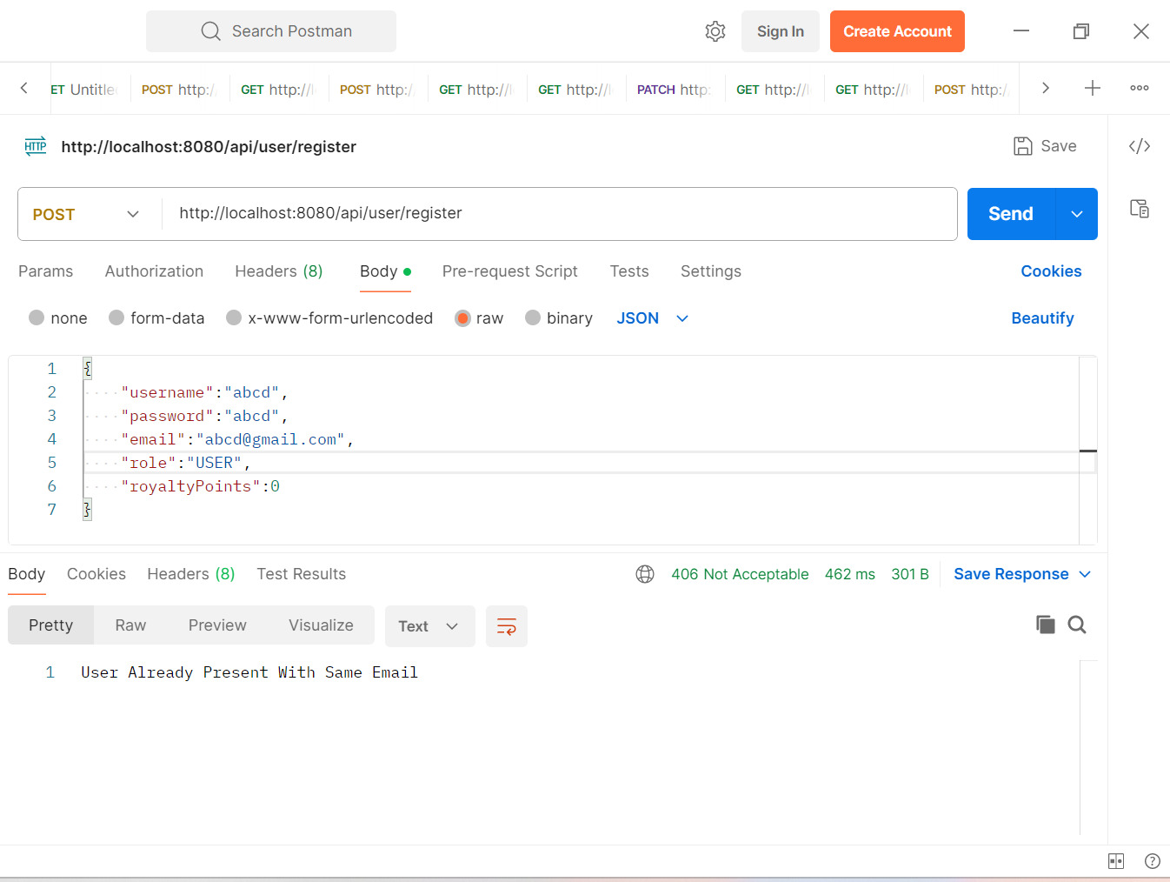
REGISTERATION PAGE [TESTING]
14

Slide 15
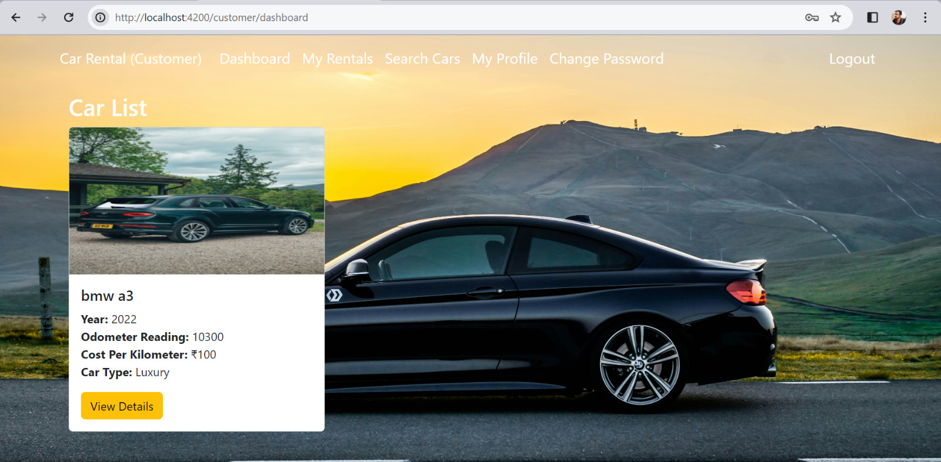
USER DASHBOARD [USER]
15

Slide 16
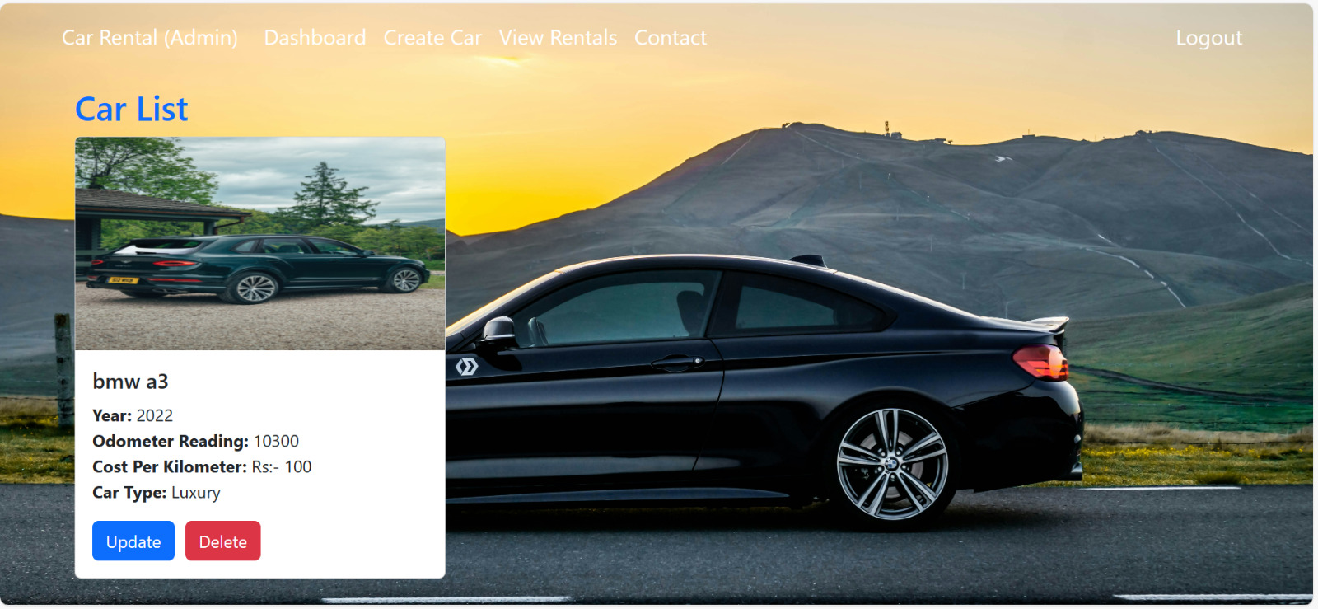
ADMIN DASHBOARD [ADMIN]
16

Slide 17
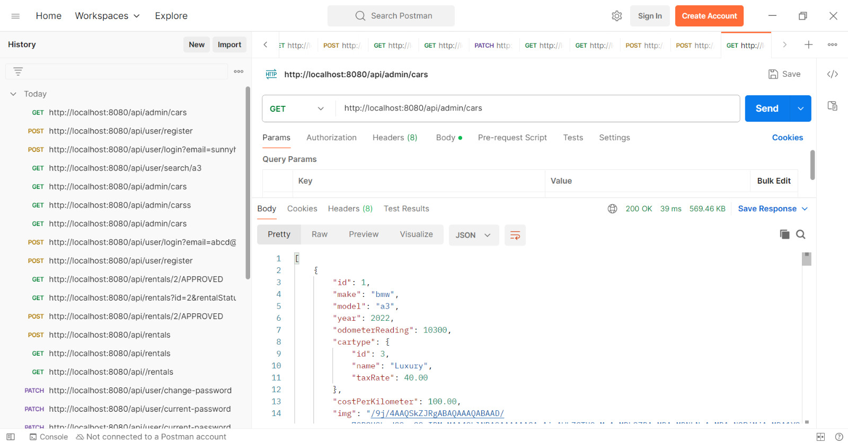
POSTMAN [TESTING]
17

Slide 18
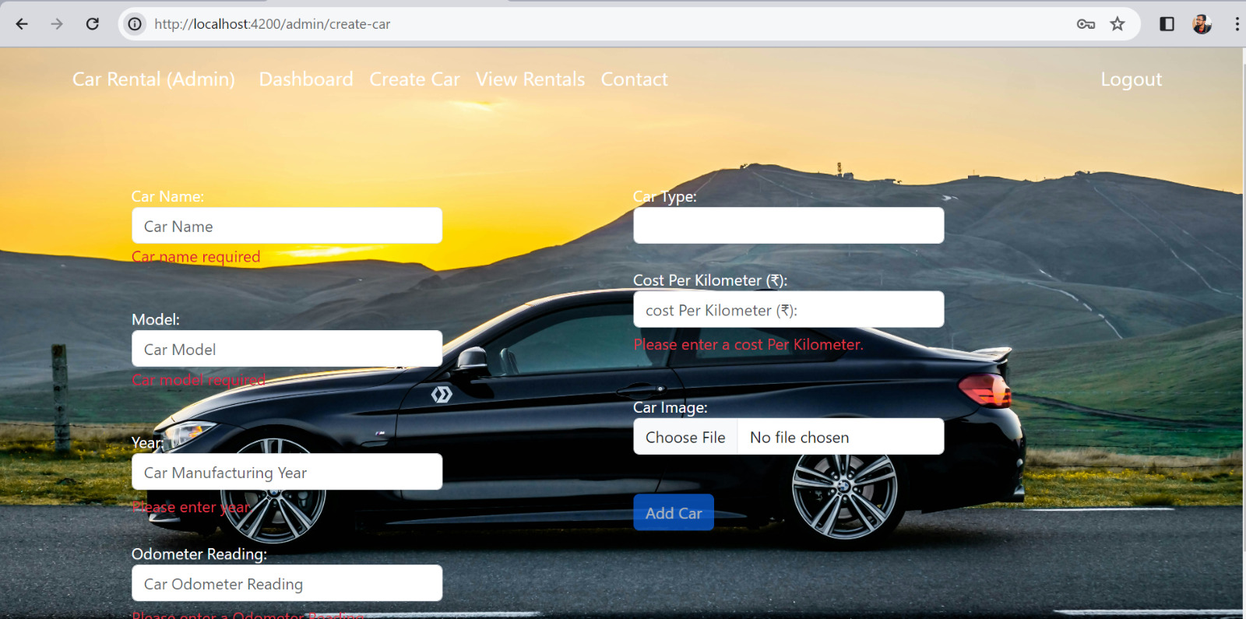
ADD CARS [ADMIN]
18

Slide 19
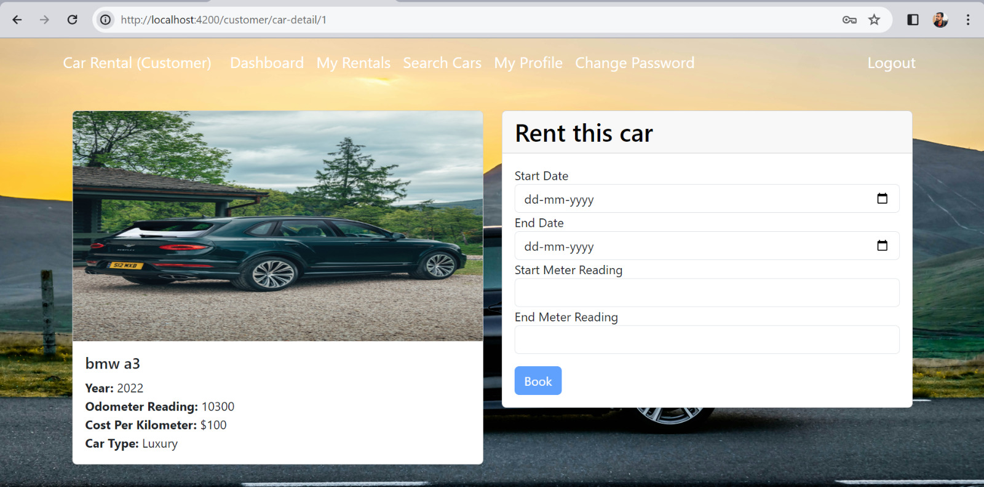
USER CAR BOOKING [USER]
19

Slide 20
Business Logic For Rental Cost
Client Order taxes :-
Basic Cars = 10%
Mid Range Cars = 20%
Hight Range Cars = 40%
Total Distance = End Odo Meter –Start Odo Meter;
Total Amount = Cost Per Km * Total Distance;
Tax Amount = total Amount * Car Type Tax / 100;
Total = total Amount + tax Amount Example :- Total Distance = 350 – 300 = 50km
Total Amount = 30rskm * 50km = 1500rs
Tax Amount = 1500 * 10bcars / 100 = 150 Total =1500 + 150 = 1600rs

Slide 21
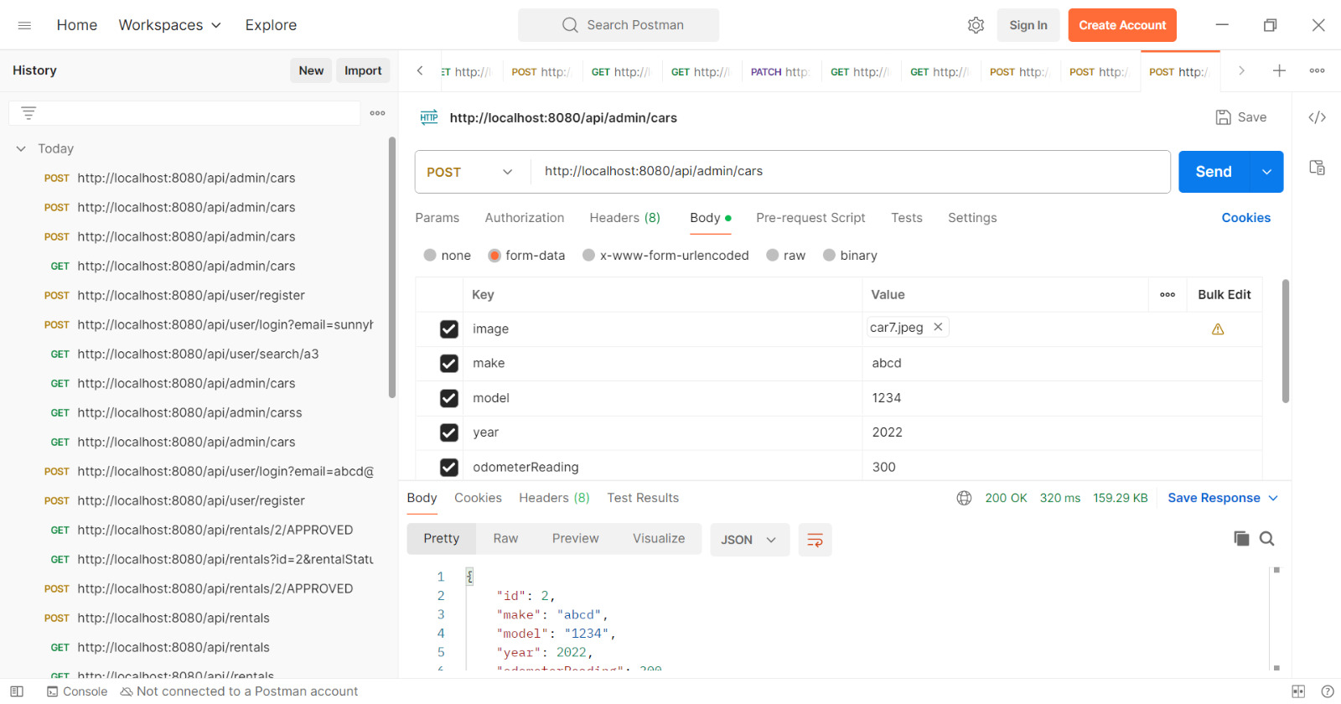
ADMIN ADDING CAR POSTMAN [TESTING]
21

Slide 22
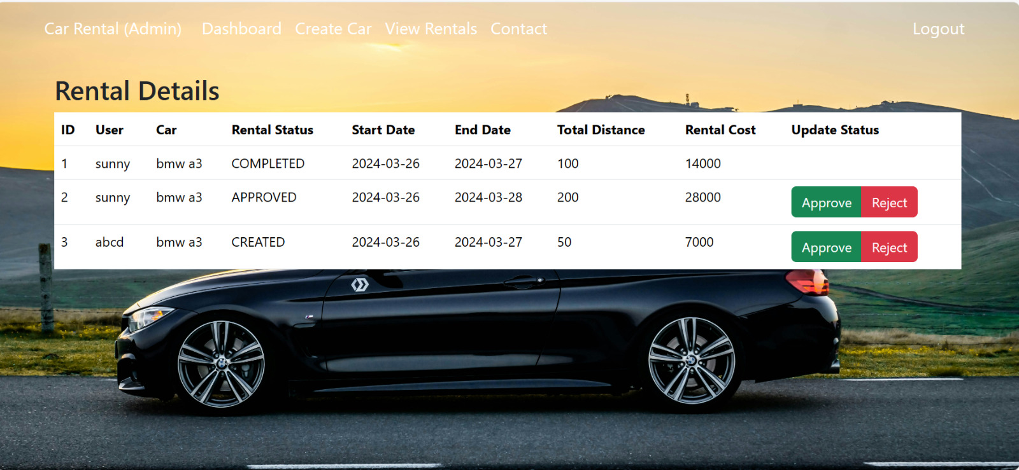
VIEW RENTALS [ADMIN]
22

Slide 23
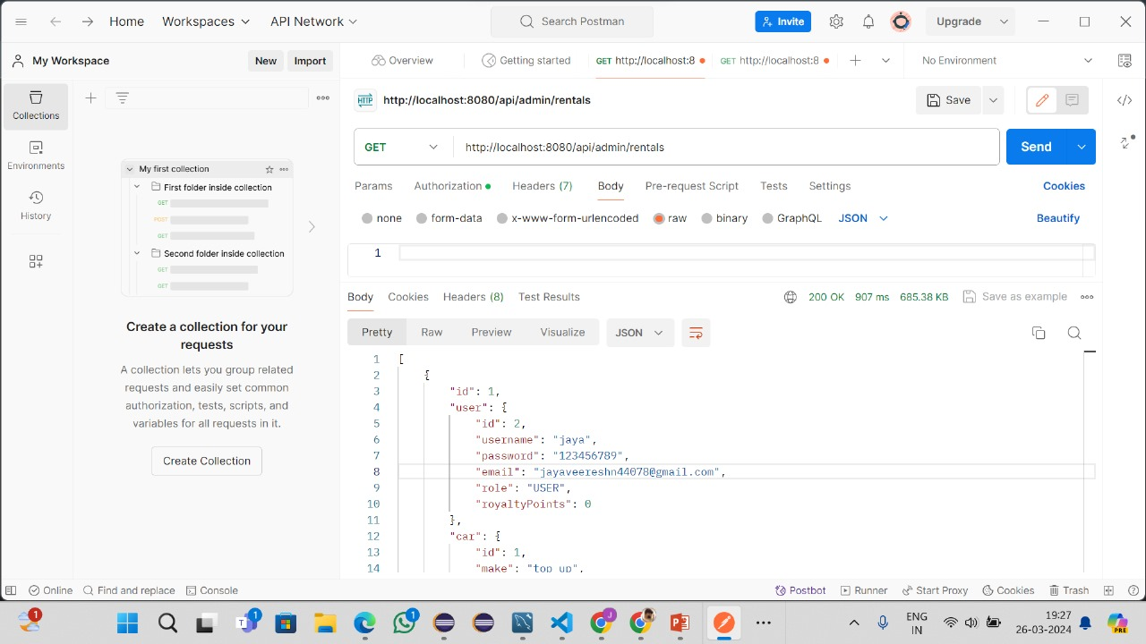
VIEW RENTALS POSTMAN [TESTING]
23

Slide 24
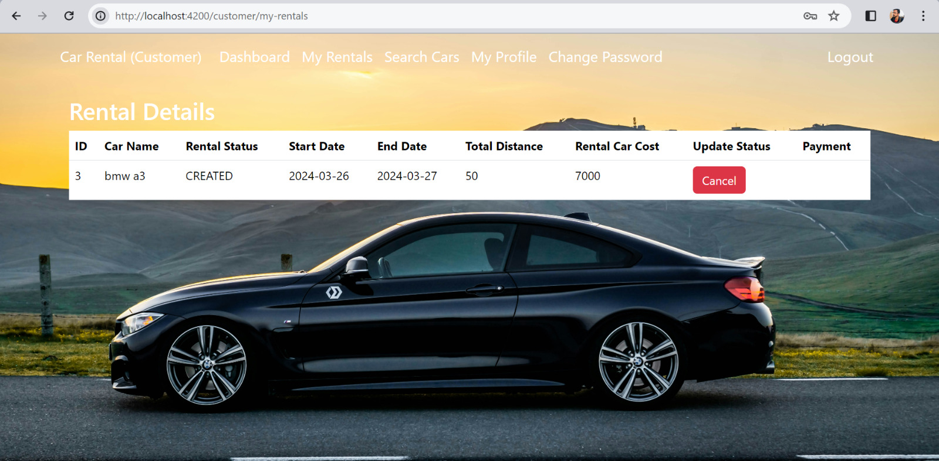
MY RENTALS [USER]
24

Slide 25
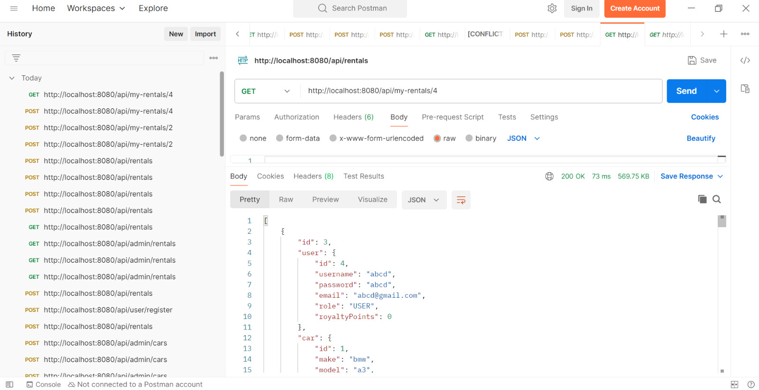
MY RENTALS POSTMAN [TESTING]
25

Slide 26
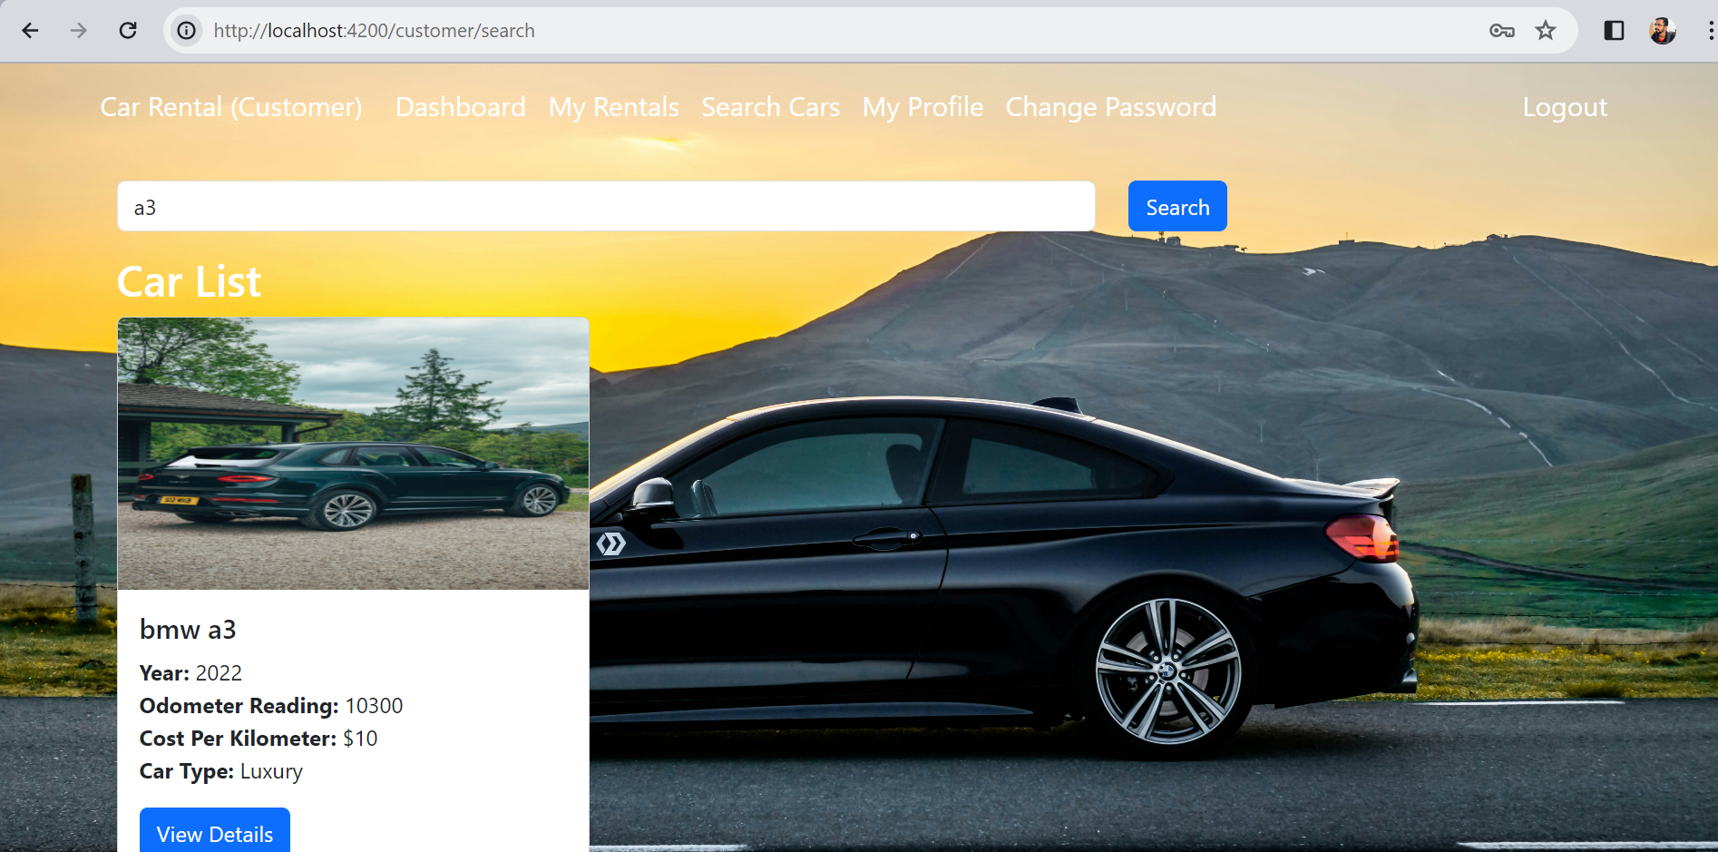
SEARCH CARS [USER]
26

Slide 27
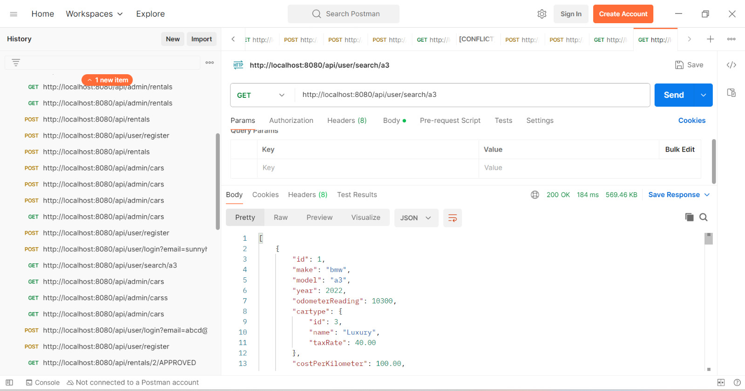
SEARCH CARS POSTMAN [TESTING]
27

Slide 28
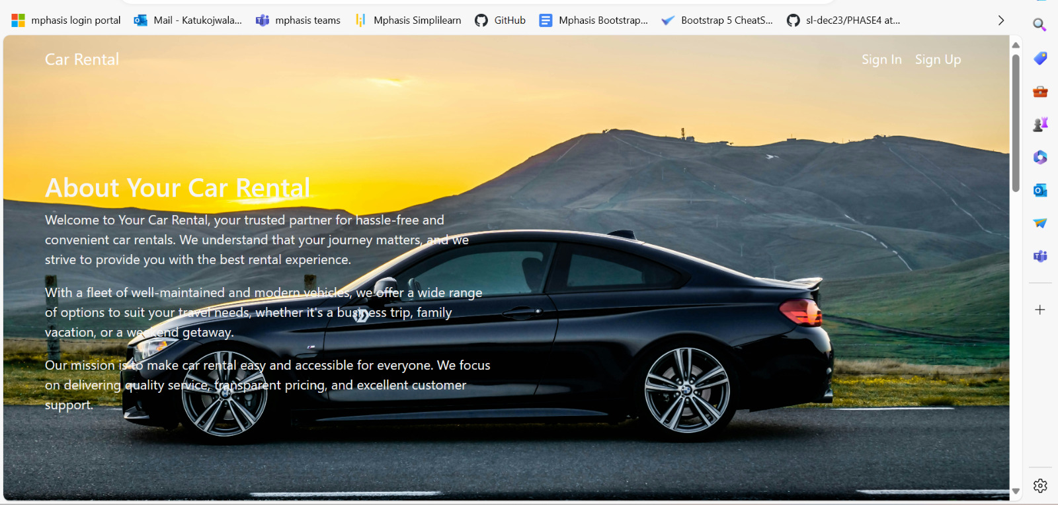
ABOUT
28

Slide 29
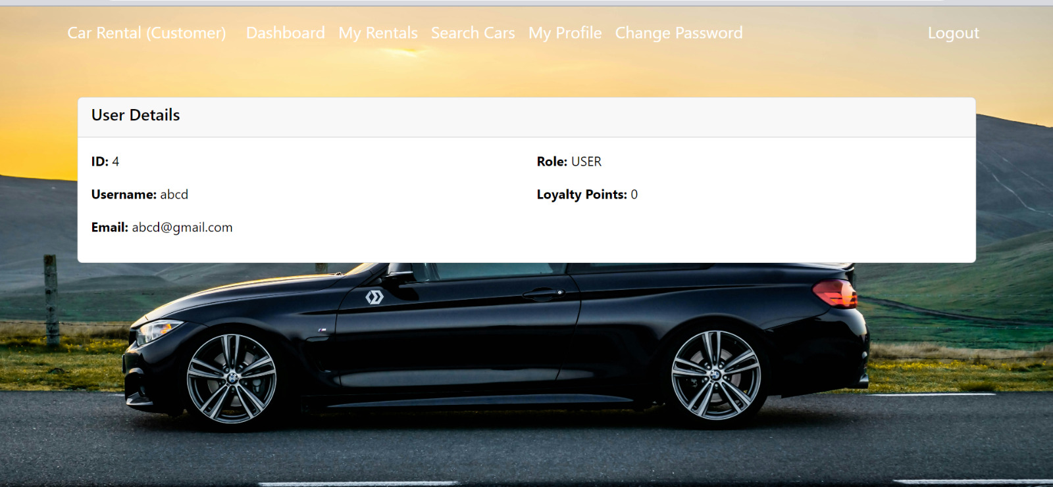
VIEW PROFILE [USER]
29

Slide 30
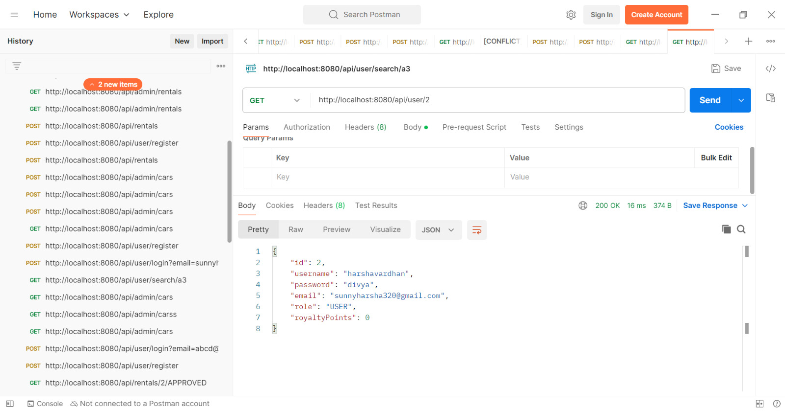
VIEW PROFILE POSTMAN [TESTING]
30

Slide 31
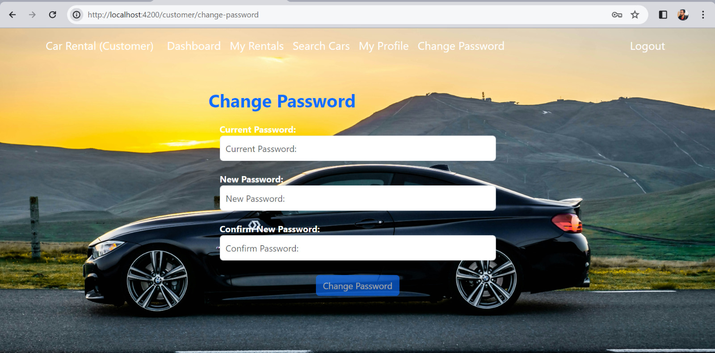
CHANGE PASSWORD [USER]
31

Slide 32
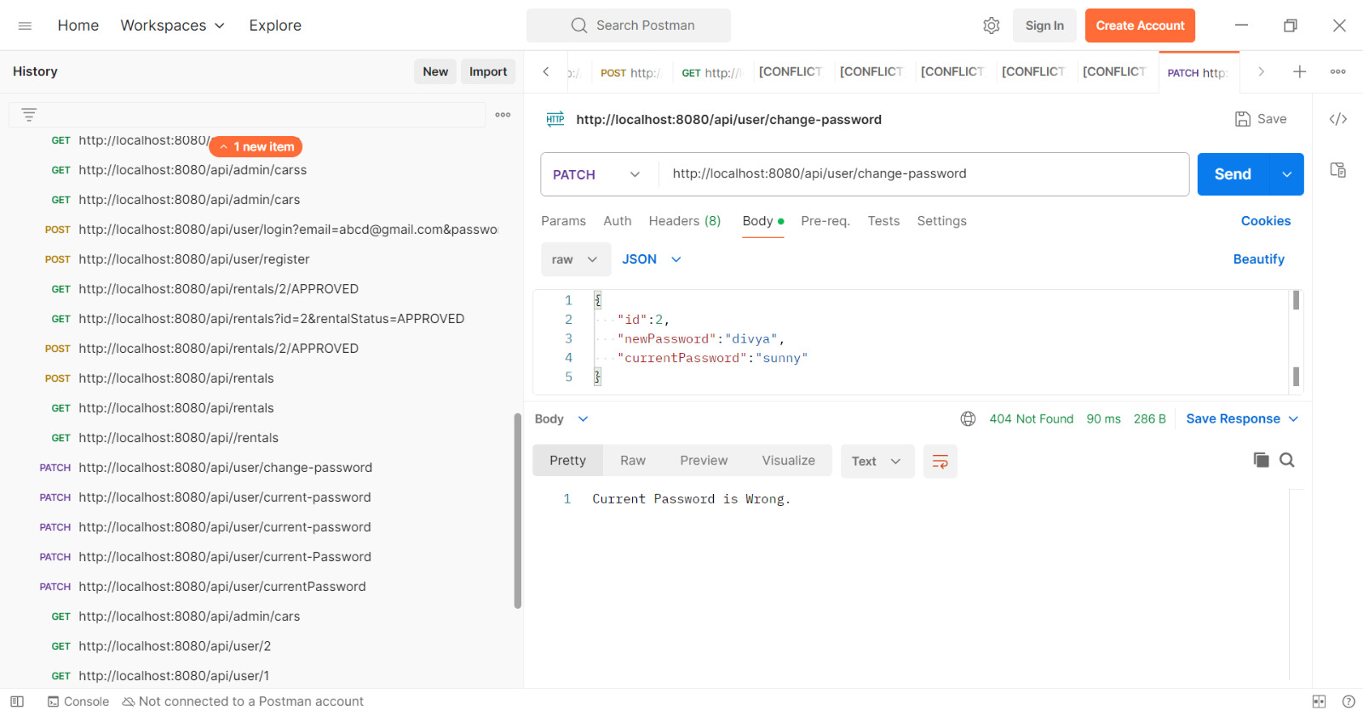
CHANGE PASSWORD POSTMAN [TESTING]
32

Slide 33
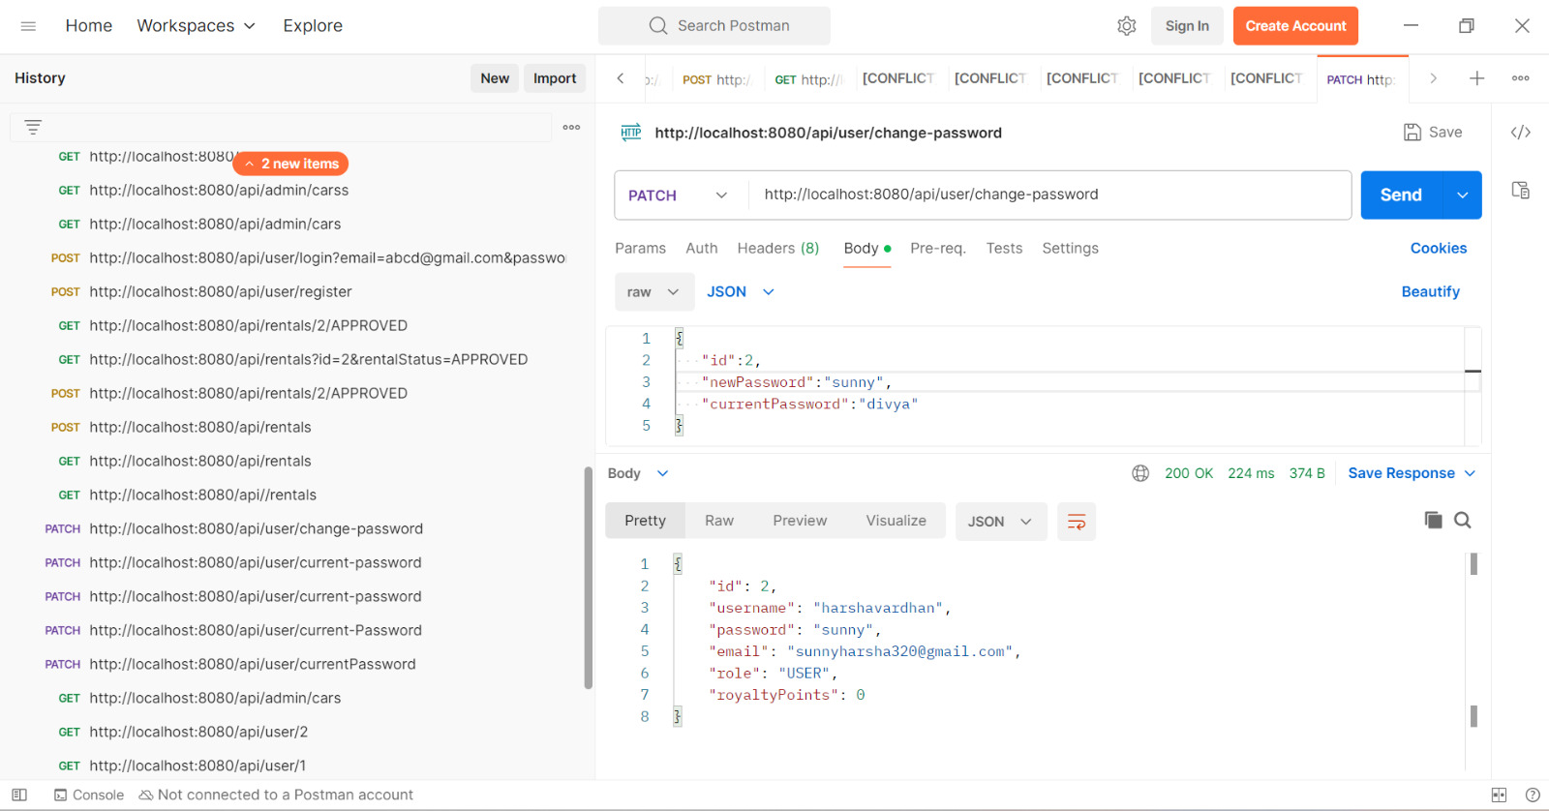
33

Slide 34
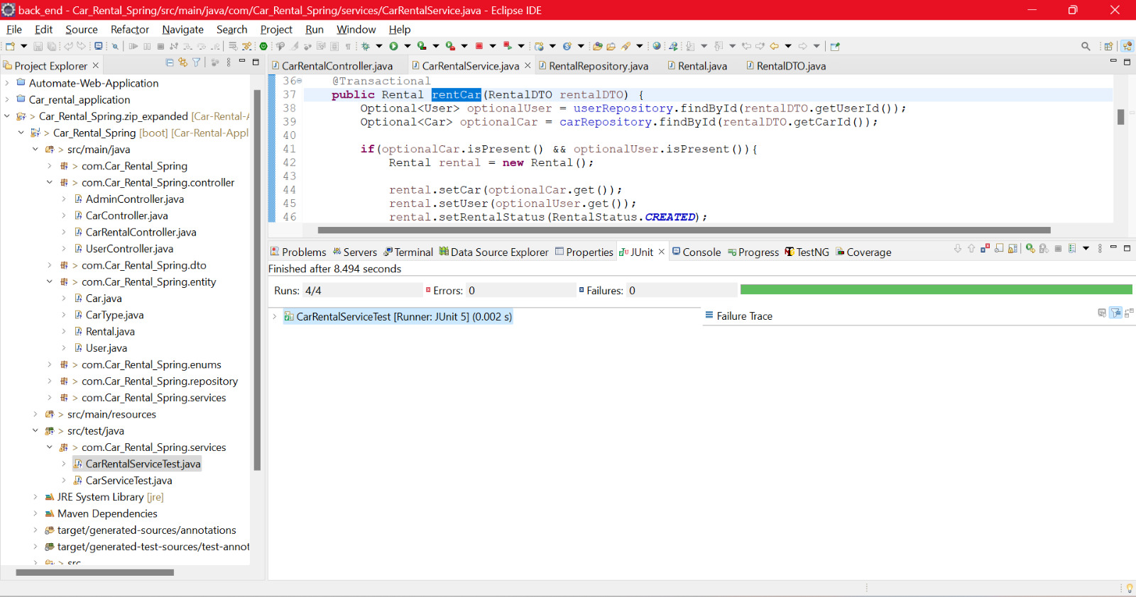
JUNIT [TESTING]
34

Slide 35
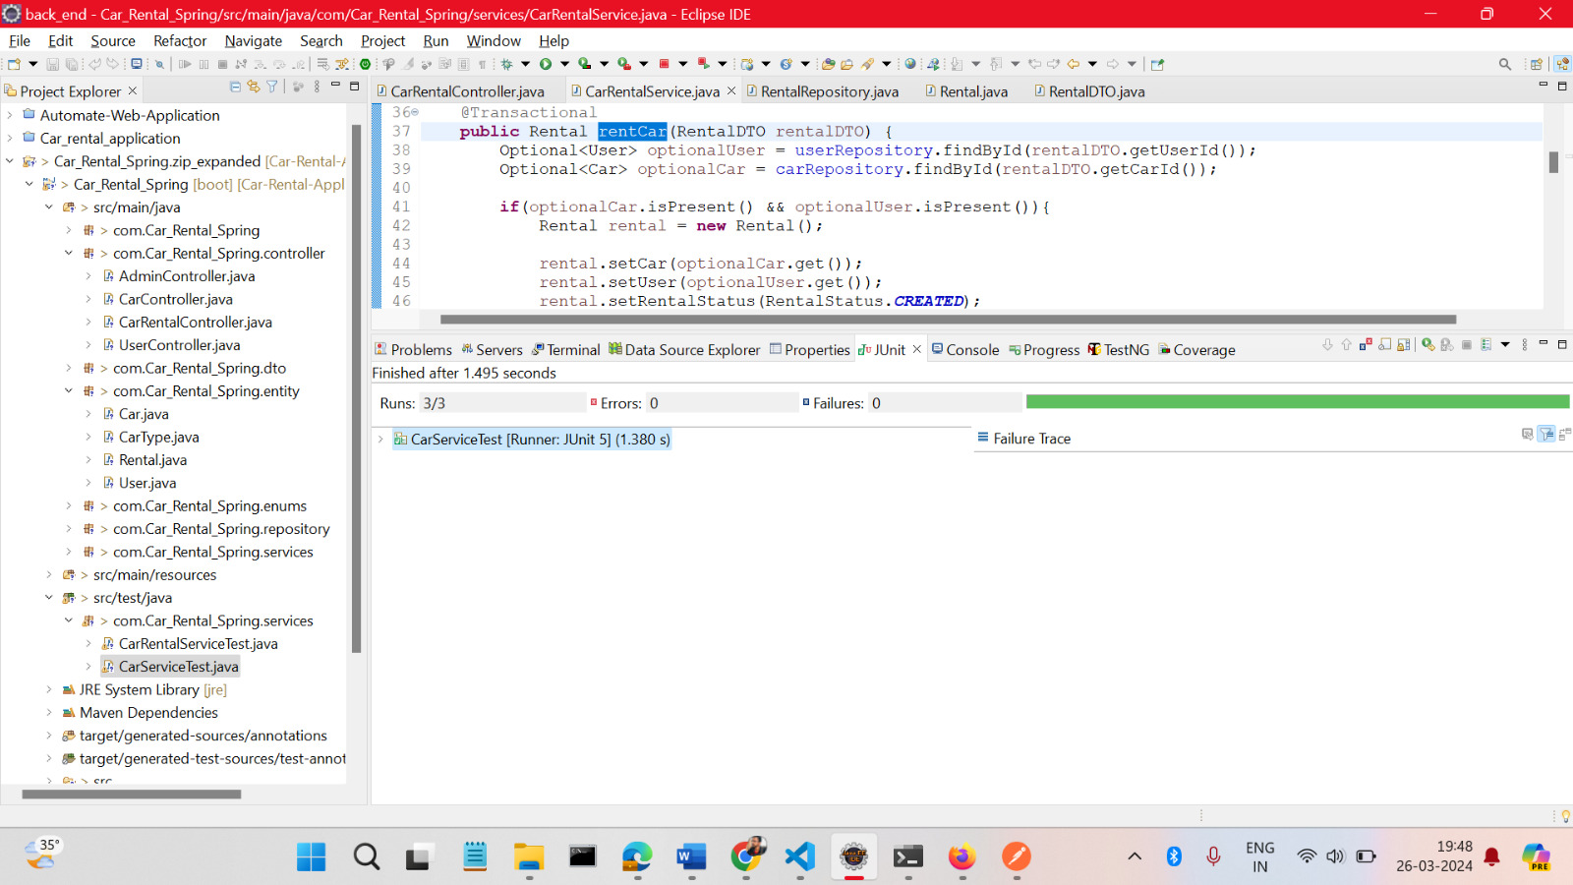
35

Slide 36
ADVANTAGES
Convenience: Customers can easily search for available cars, make reservations, and complete bookings directly from their smartphones or computers. This convenience saves time and effort compared to traditional methods of renting a car.
24/7 Availability: Users can make reservations and rent cars at any time of the day or night, as these applications are available 24/7, offering flexibility to users with varying schedules.
Transparent Pricing: Users can see the total cost of renting a car upfront, including taxes, fees, and any additional charges, which helps them make informed decisions and avoid surprises at the time of payment.
Customer Support: Users can access customer support services through the application in case of any issues or concerns during the rental period, ensuring a smoother experience overall.
Loyalty Programs and Discounts: Our car rental application offer loyalty programs, discounts, and rewards for frequent users, encouraging customer retention.

Slide 37


CONCLUSION
The website is designed to stay up to date by giving administrators the ability to update/add/delete cars on the site.
The website will store information the user may input when making a rental purchase request.
This software provides an easy-to-use interface to allow for simple access to rental requests and Customer information.
"Car Search and Display" feature offers a seamless and intuitive experience for users to browse and select from our car inventory.
37

Slide 38


Thank you

